Slide 1


Xccelerate.co
Data Science - Statistics
Topics Covered:
Intro to Statistics
Inferential versus Descriptive Statistics
Population versus sample
Spread, variance and Standard Deviation
Range and IQR
Boxplot
Mean, Median and Mode
Normal Distribution
Central Limit Theorem

Slide 2


STATISTICS
Statistics plays a crucial role in data science as it provides the tools and techniques necessary to analyze and interpret data.
Notes:
https://forms.gle/jnob3YLb33f7Zxcw5 - Feedback form

Slide 3
Some of the key areas where statistics is used in data science include:
1. Data Exploration
2. Statistical Inference
3. Predictive Modeling
Notes:
https://forms.gle/jnob3YLb33f7Zxcw5 - Feedback form

Slide 4
Inferential Statistics vs Descriptive Statistics
Descriptive statistics and inferential statistics are two branches of statistics that are used to analyze data in different ways.
Descriptive statistics is used to describe and summarize data, while inferential statistics is used to make predictions and draw conclusions about a larger population based on a sample of data. Both types of statistics are important in data analysis and are used to help make decisions based on data.

Slide 5
Descriptive Statistics
Descriptive statistics is concerned with describing and summarizing the characteristics of a sample or population. It involves measures such as mean, median, mode, range, and standard deviation, which are used to describe the central tendency, variability, and distribution of the data. Descriptive statistics are useful for giving a quick overview of the data, identifying outliers, and detecting patterns.

Slide 6
Inferential Statistics
Inferential statistics, on the other hand, is concerned with making inferences and drawing conclusions about a population based on a sample of data. It involves using statistical methods to test hypotheses, estimate parameters, and make predictions about the population. Inferential statistics are used to determine if the results observed in a sample are likely to be representative of the larger population from which the sample was drawn.

Slide 7
Population vs Sample
Population is the entire group of individuals, objects, or events that we are interested in studying.
A sample is a subset of the population that is selected to represent the population.

Slide 8
Example:
If we are interested in studying the average height of all people in a city, the population would be all the people living in that city. However, it may not be practical or feasible to measure the height of every single person in the city. In this case, we can select a sample of people from the city, measure their height, and use this sample data to estimate the average height of the entire population.

Slide 9
Spread, Variance and Standard Deviation
Spread refers to the extent to which the data is dispersed or spread out.
Variance and standard deviation are two measures of spread that are commonly used in statistics.
A large variance or standard deviation indicates that the data is spread out over a wide range, while a small variance or standard deviation indicates that the data is clustered tightly around the mean.

Slide 10
Variance
Variance is a measure of the spread of the data around its mean.
It is calculated by taking the average of the squared differences between each data point and the mean. Mathematically, the variance is given by the formula:
Var = (1/n) * Σ(xi - μ)^2
where n is the number of data points, xi is the ith data point, μ is the mean of the data.

Slide 11
Standard Deviation
The standard deviation is the square root of the variance and is expressed in the same units as the data.
It provides a measure of how much the data varies from the mean. Mathematically, the standard deviation is given by the formula:
SD = sqrt(Var)

Slide 12
Range
Range is the difference between the maximum and minimum values in a dataset. It is a simple measure of variability that gives an idea of the spread of the data.
However, range can be influenced by extreme values and may not be a good measure of variability if there are outliers in the data.

Slide 13
Inter Quartile Range
Interquartile range (IQR) is a more robust measure of variability that is not affected by outliers.
It is calculated as the difference between the upper quartile (Q3) and the lower quartile (Q1) of the data.
The quartiles divide the data into four equal parts, with Q1 representing the 25th percentile and Q3 representing the 75th percentile of the data.

Slide 14
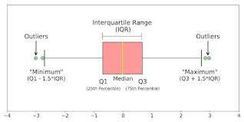
Boxplot:

Slide 15
IQR
Mathematically, IQR can be calculated as:
IQR = Q3 - Q1
IQR gives an idea of the spread of the middle 50% of the data and is often used in box-and-whisker plots to display the distribution of the data.
A large IQR indicates that the middle 50% of the data is spread out over a wide range, while a small IQR indicates that the data is clustered tightly around the median.

Slide 16
Measures of Central Tendencies:
Mean, Median, and Mode are measures of central tendency that are used to describe the typical value of a dataset.
The mean is affected by extreme values, the median is less affected by extreme values and is a more robust measure of central tendency, and the mode is the most frequently occurring value in the dataset.

Slide 17
Mean:
The mean is the arithmetic average of all the values in a dataset. It is calculated by adding up all the values in the dataset and dividing by the number of values. The mean is affected by extreme values, or outliers, in the dataset.

Slide 18
Median:
The median is the middle value of a dataset when the values are arranged in order from smallest to largest. If there are an even number of values in the dataset, the median is the average of the two middle values. The median is less affected by extreme values than the mean and is a more robust measure of central tendency.

Slide 19
Mode:
The mode is the value that appears most frequently in a dataset. If there is no value that appears more frequently than any other value, the dataset is said to have no mode. The mode is useful for describing categorical or discrete data, but it may not be a good measure of central tendency for continuous data.

Slide 20
Tip:
The mean is the arithmetic average of the values in a dataset.
The median is the middle value of a dataset when the values are arranged in order from smallest to largest.
The mode is the most frequently occurring value in a dataset.

Slide 21
Examples:
Dataset: 2, 4, 6, 8, 10
Mean: (2 + 4 + 6 + 8 + 10) / 5 = 6
Median: 6 is the middle value of the ordered dataset
Mode: There is no mode as each value appears only once.

Slide 22
Examples:
Dataset: 2, 4, 6, 8, 10, 12
Mean: (2 + 4 + 6 + 8 + 10 + 12) / 6 = 7
Median: (6 + 8) / 2 = 7
Mode: There is no mode as each value appears only once.

Slide 23
Examples:
Dataset: 2, 3, 4, 4, 4, 5, 6, 7, 8
Mean: (2 + 3 + 4 + 4 + 4 + 5 + 6 + 7 + 8) / 9 = 4.67
Median: 4 is the middle value of the ordered dataset
Mode: 4 is the mode as it appears most frequently in the dataset.

Slide 24
Normal Distribution :
Normal distribution, also known as Gaussian distribution or bell curve, is a probability distribution that is widely used in statistics and data science to model real-world phenomena.
A normal distribution is characterized by its mean (μ) and standard deviation (σ). The shape of the normal distribution is symmetrical and bell-shaped, with the majority of the data points falling close to the mean, and fewer data points at the tails of the distribution. The mean, median, and mode of a normal distribution are all equal.

Slide 25
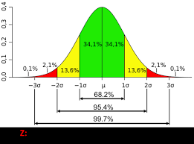
Bell curve :
The normal distribution is widely used in various fields, including finance, engineering, physics, and social sciences, to model various phenomena such as heights, weights, IQ scores, and errors in measurements.

Slide 26
Properties:
68-95-99.7 rule: Approximately 68% of the data falls within one standard deviation of the mean, 95% of the data falls within two standard deviations of the mean, and 99.7% of the data falls within three standard deviations of the mean.

Slide 27
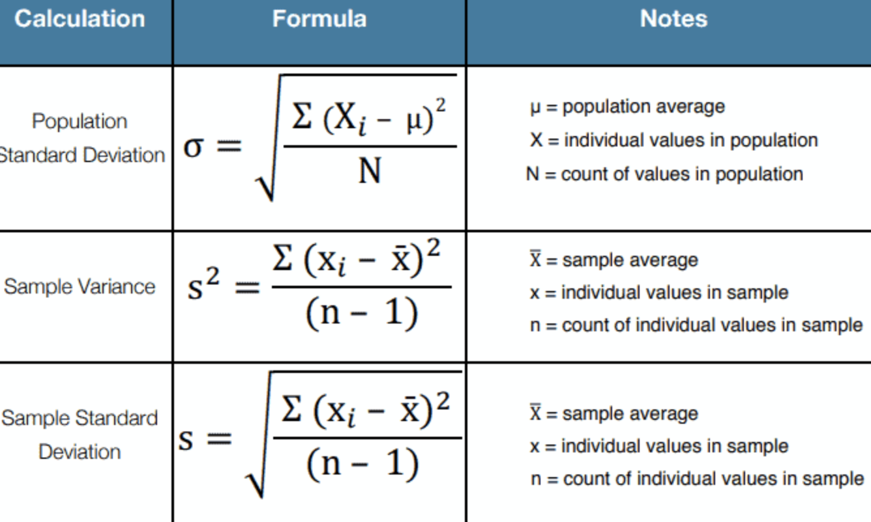
Central Limit Theorem:
The Central Limit Theorem(CLT) states that for any data, provided a high number of samples have been taken. The following properties hold:
* Sampling Distribution Mean(μₓ¯) = Population Mean(μ)
* Sampling distribution’s standard deviation (Standard error) = s
* For n > 30, the sampling distribution becomes a normal distribution.

Slide 28
Conclusion:
It is beneficial to find the mean and standard deviation for only a small representative sample.
We may have to do this because of time and money constraints. Using CLT properties, we can find the Population Mean(μ), Standard Error(σ/√n), and, most importantly, Confidence interval(y%).
CLT is beneficial in polling results reported on the news with confidence intervals, Insurance, Banking, etc. That is all about CLT and its properties and how it can be useful in Data Science.

